Slide 1

LECTURE 4: Multiagent System (MAS)
KD04203 Intelligent Agents
Taken and modified from “An Introduction to MultiAgent Systems” by Michael Wooldridge, John Wiley & Sons, 2009, COMP310 course of UoL by Terry Payne and “Agent Technology for e-Commerce” by Maria Fasli
KK04203 Intelligent Agents

Slide 2
Expected learning outcomes
Understand the concept of multiagent systems (MAS)
Understand how MAS is differs from single agent system
Discuss the application of MAS
KK04203 Intelligent Agents

Slide 3
Outline
Multiagent systems definition
Coherence
Utilities and preferences
MAS applications
Summary
KK04203 Intelligent Agents

Slide 4
Multiagent?
A system: contains more than one agent…
…which interact through communication…
…are able to act in an environment…
…have different “spheres of influence” (which may coincide) – have control over, or at least be influence, different parts of the environment (Wooldridge, 2009)
Issues: dependency, relationships
E.g. two agents want to move through a small door, or
one agent is the “boss” of another
KK04203 Intelligent Agents
KK04203 Intelligent Agents
Notes:
Able to act = mampu bertindak
Environment = persekitaran
have control over, or at least be influence = mempunyai kawalan ke atas, atau sekurang-kurangnya menjadi pengaruh
Dependency = pergantungan

Slide 5
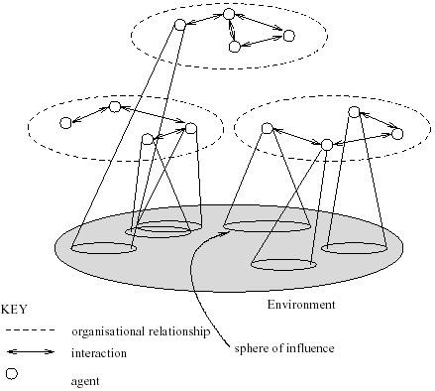
Typical Structure of a MAS
KK04203 Intelligent Agents

Slide 6
Other definition
A multiagent system is a system composed of multiple agents that interact with each other to accomplish a common goal or set of goals. These agents can be software programs, robots, or other intelligent entities that are capable of making decisions and acting independently in a given environment. The agents in a multiagent system can have varying levels of intelligence and autonomy, and they may use different methods to communicate and coordinate with each other in order to achieve their goals. Multiagent systems are often used in complex, dynamic environments where it is difficult for a single agent to achieve a desired outcome on its own.
Definition: A multi-agent system (MAS) consists of a network of loosely-coupled computational autonomous agents who can perform actions, they have resources at their disposal and they possess knowledge, capabilities or skills. They are situated in a common environment and they can interact through a set of rules, namely an interaction protocol (Fasli, 2007).
It is rare for an agent to act in isolation and it is even more rare for an agent to be useful on its own!
Notes:
loosely-coupled computational = melibatkan pengiraan yang mempengaruhi sesame sendiri
Resources at their disposal = sumber sedia ada yang untuk diguna

Slide 7
Single vs multiagent
Environment: Agents in MAS need to take into account of others agents who may interfere with their plans and goals. They (agents in MAS) need to coordinate with others agents in order to avoid conflicts.
Knowledge/expertise/skills: these are distributed
Design: agents don’t have to be homogeneous and may be designed and implemented using different methodologies and languages
Interaction: agents interact following rules of interaction (interaction protocols)
Notes:
This slide talks about multiagent
Distributed = di bahagi sama rata
Homogeneous = serupa
Methodology = kaedah
Languages = programming language

Slide 8
Coherence
Coherence in a multiagent system refers to the ability of the agents in the system to work together effectively and efficiently to achieve their common goals. A multiagent system is said to be coherent if the agents are able to coordinate their actions and communicate effectively with each other in order to accomplish their tasks. In a coherent multiagent system, the agents are able to share information and knowledge, and they are able to adapt to changing conditions in their environment. This allows the agents to function as a cohesive unit, working together to achieve their goals in an efficient and effective manner. Coherence is an important property of multiagent systems, as it enables the agents to solve complex problems that may be beyond the capabilities of a single agent.
Coherence, i.e. how well the system behaves as a unit, is important in MASs
Coherence can be measured in different ways depending on the problem domain and system
Usually measured from an external observer’s perspective who ascertains whether or not a system appears to be behaving in a coherent way – not necessarily something that the agents themselves are aware of
The system is operating coherently if the objective is achieved
Notes:
Coherence = the quality of being logical and consistent (logic dan konsisten)
Measured = diukur

Slide 9
Utilities and Preferences
Assume we have just two agents, Ag={i, j}
Agents are self-interested: they have preferences over how the environment is
Ω = {w₁, w₂, …}= the set of “outcomes” that agents have preferences over (where w = a single outcome)
We capture preferences by Utility functions:
u_{i} = Ω → ℝ
u_{j} = Ω → ℝ
Utility functions lead to preference orderings over outcomes:
w >_{i} w’ means u_{i}(w) > u_{i}(w’) w >_{j} w’ means u_{j}(w) > u_{j}(w’)
Agents that are self-interested are motivated by their own goals and interests, and they have preferences over how the environment should be based on what is best for them. This means that they may not always act in the best interests of the group or system as a whole, and they may prioritize their own rewards or benefits over the overall goals of the system. This can sometimes lead to conflicts of interest or suboptimal outcomes for the group or system. In simpler terms, self-interested agents are focused on their own needs and goals, and they may not always consider the needs and goals of others when making decisions.
KK04203 Intelligent Agents
Notes:
Preferences = keutamaan, pilihan
Outcome = hasil
R = real, reality, logical outcome
Preference ordering = susunan keutamaan/pilihan
W = outcome
Omega = set of outcome

Slide 10

Multiagent Encounters
We need a model of the environment in which these agents will act…
agents simultaneously choose an action to perform, and as a result of the actions they select, an outcome in Ω will result
the actual outcome depends on the combination of actions
assume each agent has just two possible actions that it can perform;
C (“cooperate”) and D (“defect”)
Let Ac = {C,D}
The outcome depends on the combination of actions:
Notes:
Gamma = environment behavior, defined with state transformer function

Slide 11
In this example, τ is a state transformer function that takes as input two states, D and C, and outputs a value based on the combination of the two input states. The values of ω1, ω2, ω3, and ω4 are constants that are determined by the designer of the system, and they represent the possible outcomes of the state transformer function given the input states D and C. For example, if the input to the state transformer function is (D,D), the output will be ω1. Similarly, if the input is (D,C), the output will be ω2, and so on. These values can be used by the agent to determine the possible outcomes of its actions based on the current state of the environment.
This environment is sensitive to actions of both agents:
Neither agent has influence in this environment
This environment is controlled by j.

Slide 12


Rational Action
e.g.
where
Then agent i’s preferences are:
“C” is the rational choice for i
(Because i prefers all outcomes that arise through C over all outcomes that arise through D.)
Notes:
Suppose we have the case where both agents can influence the outcome, and they have utility functions as follows:

Slide 13
MASs applications
They are particularly suitable for:
Building a systems to solve complex problems that cannot be solved by one agent
Dealing with problems that involve many problem-solving methods, that requires different types of expertise and knowledge or where there are multiple viewpoints
Creating systems where dynamic reorganization is required
Tasks in which the information resources are distributed
Notes:
To tackle multiple view points = mengatasi sudut pandangan yang perlbagai
Dynamic reorganization = pengurusan/penyusunan semula secara dinamik

Slide 14
MASs advantages
The use of MASs technology offers a number of advantages:
Extensibility and flexibility
Robustness and reliability
Computational efficiency and speed
Development and maintainability
Reusability
Reduced costs
Insert new capabilities by simply adding new agents with the respective capabilities
Notes:
Extensibility = kebolehan utk berkembang/ada ruang utk kemajuan
Robustnes = the ability to withstand or overcome adverse conditions or rigorous testing, kekuatan/kekebalan/ketahanan
Capability = keupayaan

Slide 15
MASs advantages
The use of MASs technology offers a number of advantages:
Extensibility and flexibility
Robustness and reliability
Computational efficiency and speed
Development and maintainability
Reusability
Reduced costs
One agent fails does not halt the entire system

Slide 16
MASs advantages
The use of MASs technology offers a number of advantages:
Extensibility and flexibility
Robustness and reliability
Computational efficiency and speed
Development and maintainability
Reusability
Reduced costs
Computation is performed in parallel

Slide 17
MASs advantages
The use of MASs technology offers a number of advantages:
Extensibility and flexibility
Robustness and reliability
Computational efficiency and speed
Development and maintainability
Reusability
Reduced costs
Different agents may be developed and maintained by different developers

Slide 18
MASs advantages
The use of MASs technology offers a number of advantages:
Extensibility and flexibility
Robustness and reliability
Computational efficiency and speed
Development and maintainability
Reusability
Reduced costs
The developed agents can be used in other systems

Slide 19
MASs advantages
The use of MASs technology offers a number of advantages:
Extensibility and flexibility
Robustness and reliability
Computational efficiency and speed
Development and maintainability
Reusability
Reduced costs
Agents are relatively low-cost units to develop and maintain, compared to the entire system

Slide 20
MAS challenges
A number of issues with regards to their design and implementation:
To find an efficient and effective interaction protocols
Task and problem formulation, decomposition, task allocation to individual agents and subtask synthesis
How to identify other agents, search and location in open systems
To develop a coherent and stable system behaviour while avoiding harmful interactions
Notes:
Decomposition = penguraian, pengasingan agent

Slide 21
Representation of information about the state of the environment, as well as other agents, their actions and knowledge
Team and organization formation
Efficient planning and learning algorithms

Slide 22
Closed MASs
Static design with pre-defined components and functionalities
The properties of the system are known in advance:
common language
each agent can be developed as an expert
agents are cooperative
multiple developers can work towards the development of the system at the same time
Example: a MAS in an organization
Notes:
Static design = component sudah fix, functionalities sudah ditakrifkan, garis panduan sudah sedia ada

Slide 23
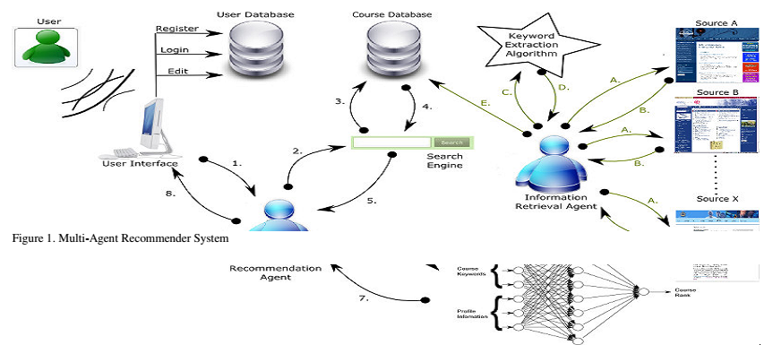
Example: MAS Recommender System for Human Capacity Building¹
Example of Closed MAS
¹V.N. Marivate, G. Ssali and T. Marwala, An intelligent multiagent recommender system for human capacity building, MELECON 2008.

Slide 24
Advantages
Distributed load and expertise
Simplicity and predictability, since
components are known
interaction language and protocols are known
agents usually are cooperative
agents share architecture and software

Slide 25
Disadvantages
Maintenance costs can be high
May be less fault tolerant
If one expert fails, then the whole system may halt
Difficult to inter-operate with other systems
Notes:
Kurang tolenransi

Slide 26
Example: MAS Recommender System for Human Capacity Building¹
¹V.N. Marivate, G. Ssali and T. Marwala, An intelligent multiagent recommender system for human capacity building, MELECON 2008.

Slide 27
Example: MAS Recommender System for Human Capacity Building¹
Reactive agents:
Get user profile
User type and search courses on search engine
Search courses algorithm activate
Return courses
Search engine Get the searched courses
Rank the courses
Get courses’ rank
Recommend courses to user
¹V.N. Marivate, G. Ssali and T. Marwala, An intelligent multiagent recommender system for human capacity building, MELECON 2008.

Slide 28
Example: MAS Recommender System for Human Capacity Building¹
Proactive agents:
Goes to service provider (www)
Mine information
Extract keyword from retrieved website
Return keywords
Add courses to database
¹V.N. Marivate, G. Ssali and T. Marwala, An intelligent multiagent recommender system for human capacity building, MELECON 2008.

Slide 29
Open MASs
The system has no prior static design, only single agents within
Agents are not necessarily aware of others – a mechanism for identifying, searching and locating others is required
Agents may be non-cooperative, malicious or not trustworthy
Example: open electronic marketplaces
Notes:
malicious = berniat buruk
open electronic marketplaces = contoh2 selain amazon, ebay, alibaba (website2 yang meragukan)

Slide 30
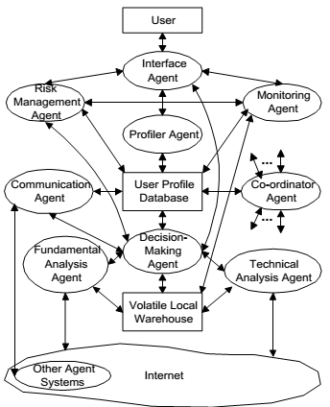
Example: A MAS Framework for Stock Trading²
²D. Davis, A multiagent framework for stock trading, 16th IFIT World Computing Congress, 2000

Slide 31
Example: A MAS Framework for Stock Trading²
Communication between agents using MASST-ACL based on Knowledge Query Manipulation Language (KQML) and Knowledge Interchange Format (KIF)
²D. Davis, A multiagent framework for stock trading, 16th IFIT World Computing Congress, 2000
Notes:
MASST = Multi-Agent System for Stock Trading - Agent Communication Language

Slide 32
Advantages
Single agent or groups are designed separately (modular)
Flexible and fault tolerant
Evolutionary design
Easier to maintain
Dynamic, open society
Notes:
Modular = employing a module as the basis of design.

Slide 33
Disadvantages
Overall behaviour of the system not predictable
Protocols, languages, ontologies may vary across agents
Malicious behaviour difficult to avoid
Notes:
Ontology = a set of concepts and categories in a subject area that shows their properties and the relations between them.

Slide 34
Summary
Definition to MAS have been given
Utilities and preferences of MAS were described
Example of applications of MAS were discussed
What’s next?
Interactions
KK04203 Intelligent Agents

